Slide 1
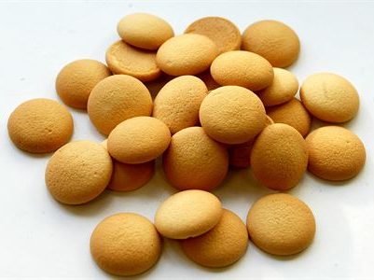
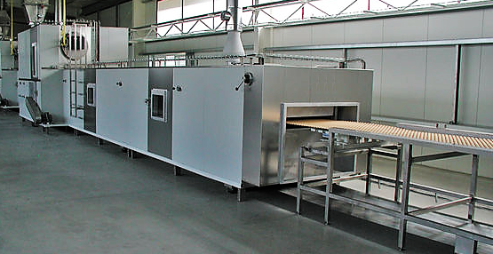
Supplier of wide range confectionery lines
Projecting|Delivery|Installation|Start up|Staff training|After sales service
Sponge Cookies Production Line
This is a very popular cookie in Europe intended mainly for children. It features by its simplicity, has a crispy structure and just melts in your mouth. It is possible to use it at home for preparing various sweets with fruits.
.
OUR ONLY LIMIT
IS YOUR IMAGINATION…
info@dvorak-online.com
www.dvorak-engineering.com

Slide 2
Supplier of wide range confectionery lines
Projecting|Delivery|Installation|Start up|Staff training|After sales service
Sponge Cookies Production Line
This product is perfect for schools and kindergartens where it can be used for snacks.
.
Product: Sponge cookie
Size: Ø 28-35 mm
Weight: 1,4-1,8 gr
Capacity: from 200 kg/hour
OUR ONLY LIMIT
IS YOUR IMAGINATION…
info@dvorak-online.com
www.dvorak-engineering.com

Slide 3
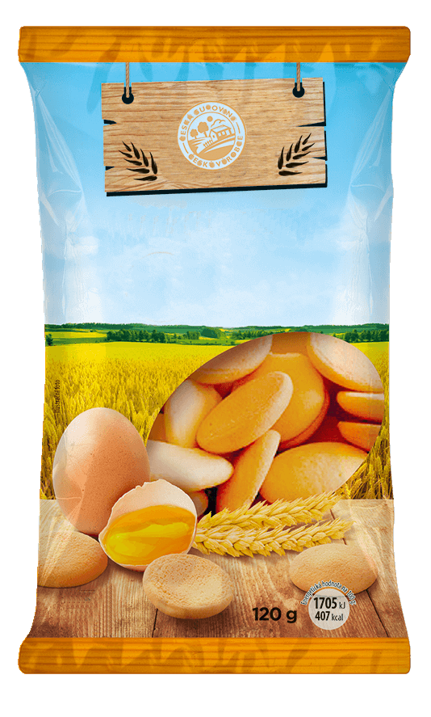
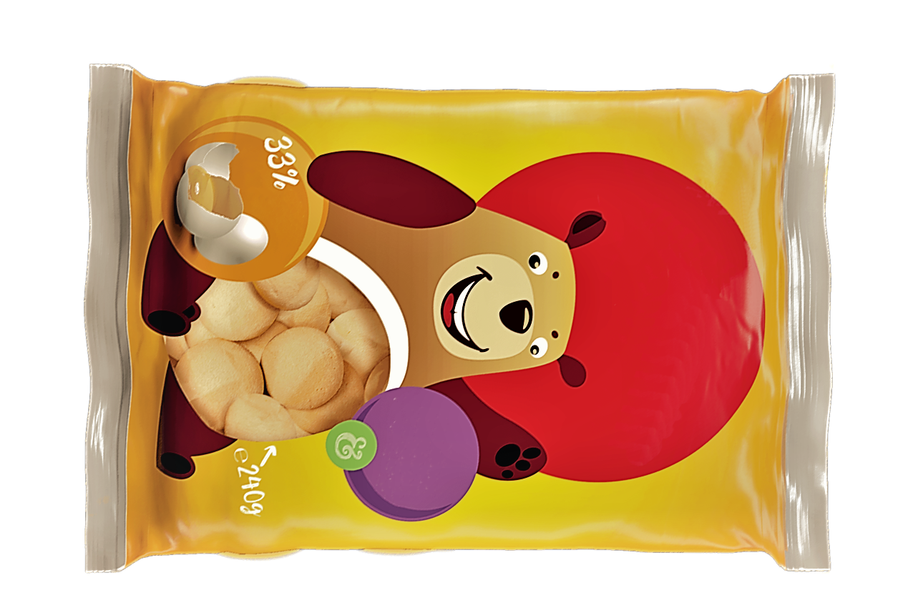
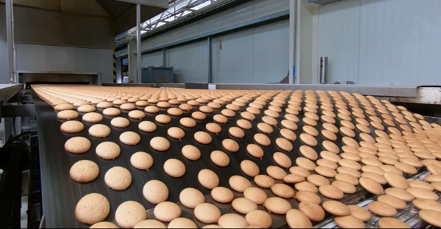
Supplier of wide range confectionery lines
Projecting|Delivery|Installation|Start up|Staff training|After sales service
SPONGE COOKIES
Sponge Cookies Production Line
The production of sponge cookies is very simple. The line consists of dough preparation, dough depositing on the all-metal oven belt, cooling conveyor and packaging by the vertical packaging machine. The all-metal oven belt is cleaned and greased automatically.
.
SPONGE
COOKIES
OUR ONLY LIMIT
IS YOUR IMAGINATION…
info@dvorak-online.com
www.dvorak-engineering.com

Slide 4
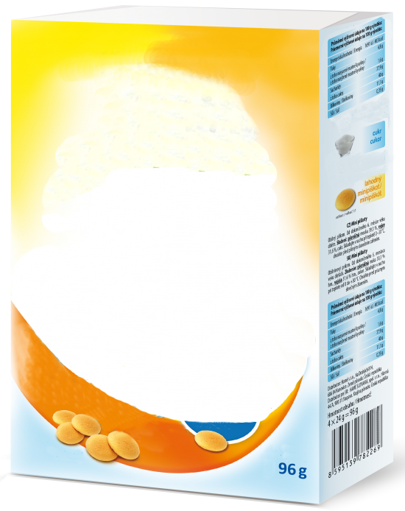
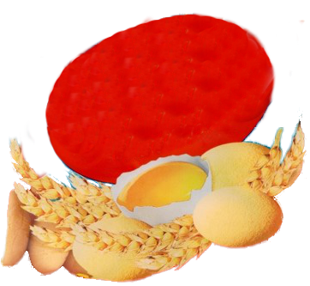
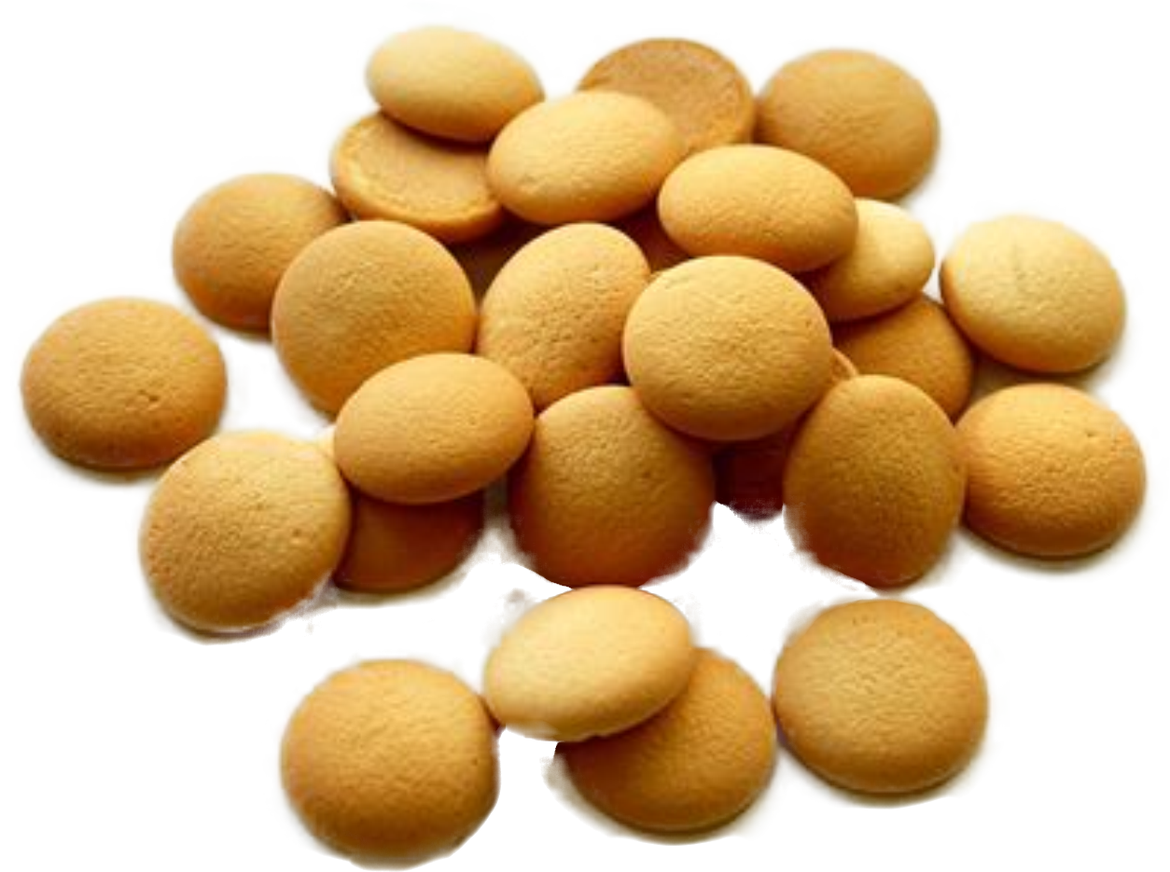
Supplier of wide range confectionery lines
Projecting|Delivery|Installation|Start up|Staff training|After sales service
Sponge Cookies Production Line
.
SPONGE COOKIES
If this topic is interesting for you, let us know and we will send you a detailed quotation.
We are at your disposal !
info@dvorak-online.com
OUR ONLY LIMIT
IS YOUR IMAGINATION…
info@dvorak-online.com
www.dvorak-engineering.com

