Slide 1

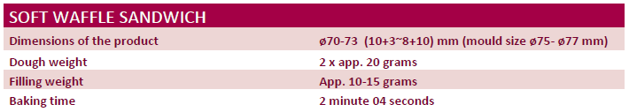
Confectionery lines supplier
Projecting|Delivery|Installation|Start up|Staff training|After sales service
Soft Waffle Sandwiching Line
3000 pcs. sandwiched waffles per hour
OUR ONLY LIMIT
IS YOUR IMAGINATION…
info@dvorak-online.com
www.dvorak-engineering.com

Slide 2
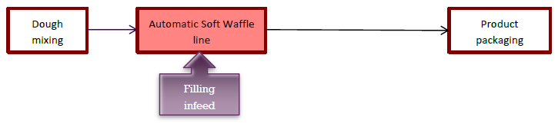
Confectionery lines supplier
Projecting|Delivery|Installation|Start up|Staff training|After sales service
DESCRIPTION OF THE PRODUCTION PROCESS OF SOFT WAFFLES.
The complete production process of Soft Waffle line can be divided in 3 stages:
Schematic drawing of product manufacturing steps.
Dough mixing. Can be performed by using a planetary mixer(s). Dough mixing process also can be fully automated by using a continuous mixing and transfer systems. This choice should be done by the customer, depending on the available budget and convenience preferences.
Making of Soft Waffle. At this stage you will use the automatic Soft Waffle Line. Normally, in production of these cakes are used ready-to-use fillings, supplie in buckets or plastic bags. Product cooling is included.
Product packaging. For packaging of pancakes is needed a flow-wrapping machine.
OUR ONLY LIMIT
IS YOUR IMAGINATION…
info@dvorak-online.com
www.dvorak-engineering.com

Slide 3
Confectionery lines supplier
Projecting|Delivery|Installation|Start up|Staff training|After sales service
DESCRIPTION OF THE AUTOMATIC SOFT WAFFLE SANDWICHING LINE
1. Depositing of dough on hot plates.
• Dough is deposited on baking moulds
on the plates.
• Baking plates are direct gas heated.
2. Top-heating.
• Electrical top heating for a prefect result
• Final baking process before cooling
3. Depanning
• Waffle cakes are picked up by needles.
4.Turning over the waffle
• 4 rows of waffles are turned over .
OUR ONLY LIMIT
IS YOUR IMAGINATION…
info@dvorak-online.com
www.dvorak-engineering.com

Slide 4
Confectionery lines supplier
Projecting|Delivery|Installation|Start up|Staff training|After sales service
DESCRIPTION OF THE AUTOMATIC SOFT WAFFLE SANDWICHING LINE
5. Cooling waffle
• Cakes are transferred to cooling conveyor
6. Aligning waffle
• Cakes are aligned before transferring to filling
and sandwiching conveyor
7. Filling depositing.
• Volumetric filling depositing for best result.
• Depositing on the bottom side.
8. Sandwiching
• Cross feeding of top cakes and sandwiching.
OUR ONLY LIMIT
IS YOUR IMAGINATION…
info@dvorak-online.com
www.dvorak-engineering.com

Slide 5
Confectionery lines supplier
Projecting|Delivery|Installation|Start up|Staff training|After sales service
DESCRIPTION OF THE AUTOMATIC SOFT WAFFLE SANDWICHING LINE
9. Pressing
• In order to spread filling cakes are pressed.
10. Transferring to cross conveyor
• The final products are transferred to cross
conveyor and curve conveyor by shuttle edge
conveyor.
OUR ONLY LIMIT
IS YOUR IMAGINATION…
info@dvorak-online.com
www.dvorak-engineering.com

Slide 6
Confectionery lines supplier
Projecting|Delivery|Installation|Start up|Staff training|After sales service
DESCRIPTION OF THE LINE UNITS
(waffle sandwich only)
Schematic drawing of a Soft Waffle Sandwiching line.
OUR ONLY LIMIT
IS YOUR IMAGINATION…
info@dvorak-online.com
www.dvorak-engineering.com

Slide 7
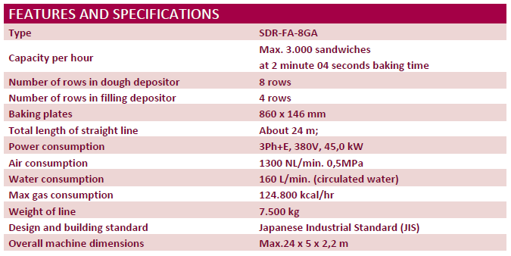
Confectionery lines supplier
Projecting|Delivery|Installation|Start up|Staff training|After sales service
SOFT WAFFLE LINE SPECIFICATION
If this topic is interesting for you, let us know and we will send you a detailed quotation.
OUR ONLY LIMIT
IS YOUR IMAGINATION…
info@dvorak-online.com
www.dvorak-engineering.com

