Slide 1
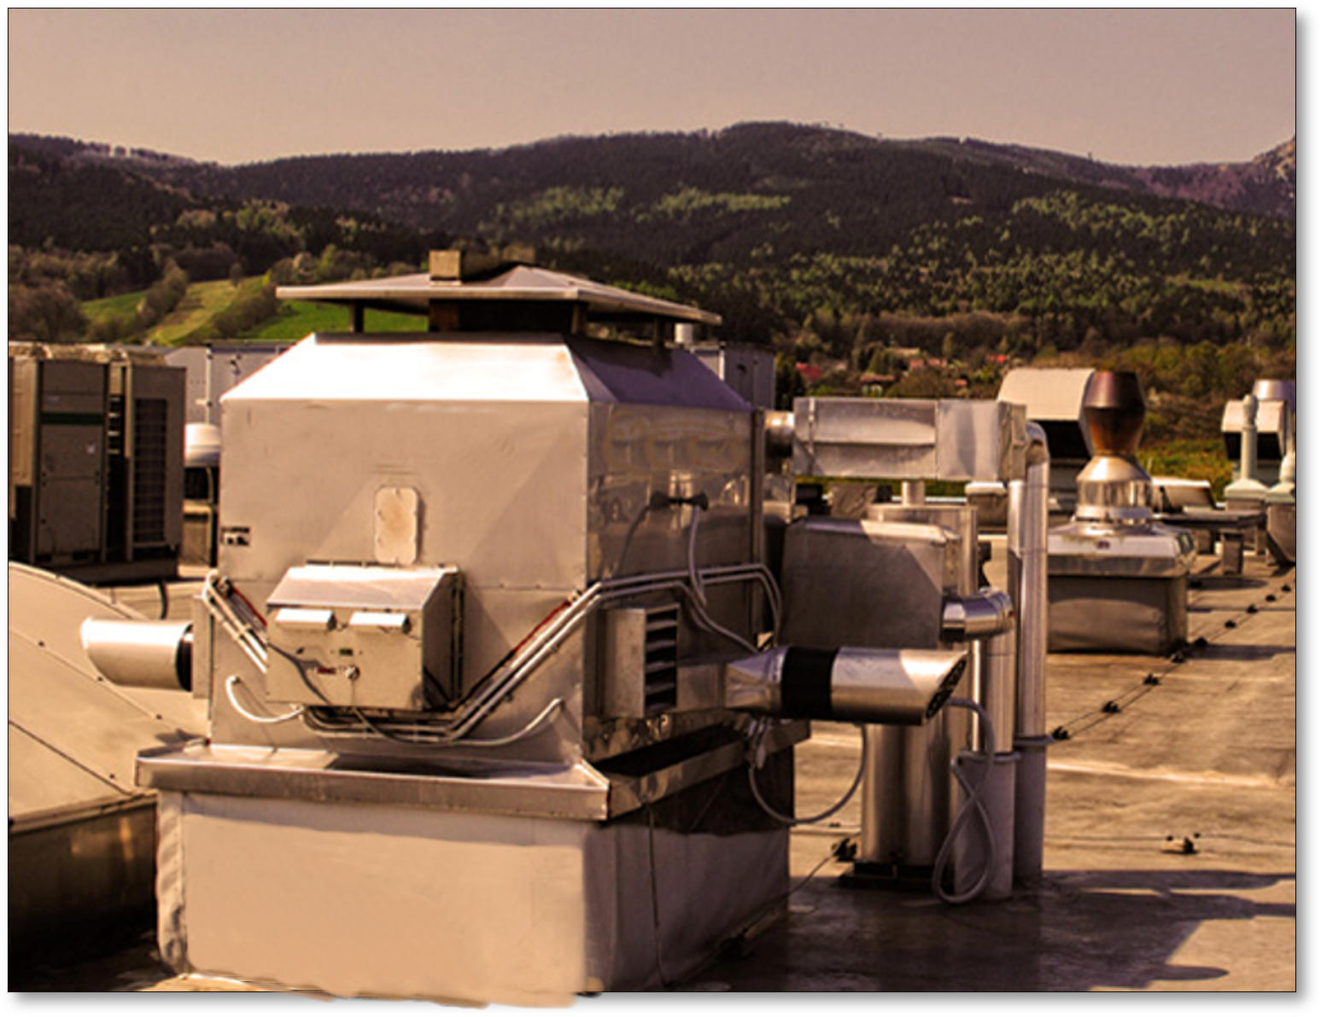
Projecting|Delivery|Installation|Start up|Staff training|After sales service
FLUE GAS HEAT EXCHANGERS
Use of waste heat in bakery businesses.
Energy savings
Currently, there is a dramatic increase in the prices of input energy, especially of natural gas.
Bakeries and confecitonery companies are already implementing measures to use waste heat from:
BAKERY OVENS/ STEAM BOILERS/ STEAM GENERATORS and THERMO-OIL BOILERS.
The way how to use waste heat is:
FGHE
FLUE GAS HEAT EXCHANGERS(FGHE)
INSTALLATION OF FLUE GAS HEAT EXCHANGERS !
OUR ONLY LIMIT
IS YOUR IMAGINATION…
info@dvorak-online.com
www.dvorak-engineering.com

Slide 2
Projecting|Delivery|Installation|Start up|Staff training|After sales service
FLUE GAS HEAT EXCHANGERS
Basic characteristics of Flue Gas Heat Exchangers (FGHE)
Extremely low pressure losses
High heat transfer efficiency
Absolute operation safety - Bypass
Performance adjustability
Cleanability of exchangers
Long-term durability-Antikoro
It does not occupy usable space in a bakery plant
Certified product
Where to use waste heat from BAKERY OVENS/STEAM BOILERS/ STEAM GENERATORS and THERMO – OIL BOILERS?
OUR ONLY LIMIT
IS YOUR IMAGINATION…
info@dvorak-online.com
www.dvorak-engineering.com

Slide 3
Projecting|Delivery|Installation|Start up|Staff training|After sales service
FLUE GAS HEAT EXCHANGERS
How to use waste heat :
Boiler rooms
ORC unit
FGHE FLUE GAS HEAT EXCHANGER
FGHE FLUE GAS HEAT EXCHANGER
Absorption cooler
Electricity
FGHE
Temperature gradient of water 80/60 °C or 110/90 °C
ADVANTAGES:
Low pressure losses (from 5 Pa)
High operating temperatures of the flue gases (max.650 °C)
High operating temperature of heating water (operationally up to 130 °C)
Easy to clean
Cooling gradient of water 7/13 °C
The ORC unit generates power from the waste heat from the flue gas heat exchangers, which can be used either for its own use or for the mains.
OUR ONLY LIMIT
IS YOUR IMAGINATION…
Air-conditioning unit
info@dvorak-online.com
www.dvorak-engineering.com

Slide 4
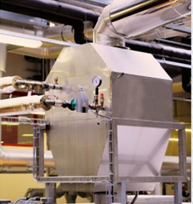
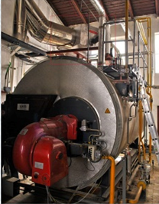
Projecting|Delivery|Installation|Start up|Staff training|After sales service
FLUE GAS HEAT EXCHANGERS
Where to use waste heat
Heating of water for steam production
Heating of hot utility and technological water
Hot water heating of buildings
Heating of proofers
Drying of production and ingredients
By combining individual energy-saving measures, it is possible to achieve the energy consumption savings between 35% - 50% in bakery companies.
By using waste heat, it is possible to obtain 12% of the energy entering the bakery oven, which represents an output of around 25-55 kW, depending on the oven type.
Next to this, the consumption of natural gas is saved by eliminating the heating-up of feed water, hot water and of heating, which operate with efficiencies between 80-90%.
OUR ONLY LIMIT
IS YOUR IMAGINATION…
Substitution of electric heating-up for heating-up from waste heat.
info@dvorak-online.com
www.dvorak-engineering.com

Slide 5
Projecting|Delivery|Installation|Start up|Staff training|After sales service
FLUE GAS HEAT EXCHANGERS
Use of waste heat/Energy savings
Flue Gas Heat Exchangers are installed in the chimney paths of thermal equipment. The devices have very low pressure losses. They are equipped with a regulatory control unit ensuring optimal operation and with a safety emergency system in the event of an accident or malfunction.
The whole system is fitted with a control unit with the possibility of graphical visualisation to the control computer. The waste heat utilization system is equipped with storage tanks for the elimination of energy consumptions and for waste heat obtaining. Based on concrete data of water consumption and operating hours of each oven, a thermal energy consumption curve is created and the entire system is adjusted according to the exact needs of the user.
OUR ONLY LIMIT
IS YOUR IMAGINATION…
info@dvorak-online.com
www.dvorak-engineering.com

Slide 6
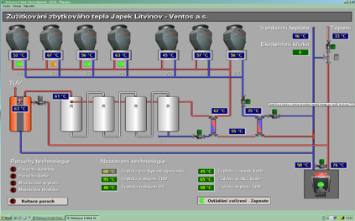
Projecting|Delivery|Installation|Start up|Staff training|After sales service
FLUE GAS HEAT EXCHANGERS
Graphical visualisation of waste heat utilization
With the current price increase of natural gas, the return on investment is in the range of 3-5 years, depending on operating hours, size and possibilities of financing.
Dvorak-engineering offers to prepare to bakeries and confectionery companies a free price quotation for the installation of a flue gas heat exchanger, based on specific energy needs during the day.
If this topic is interesting for you, please let us know - we will send more detailed information.
OUR ONLY LIMIT
IS YOUR IMAGINATION…
info@dvorak-online.com
www.dvorak-engineering.com

